Slide 1
Lab 5: 1D spatial models with unequal distances
April 26, 2018

Slide 2

Coastline (sites are blue circles)
Imagine that:
$$c_{s}\left(i\right)\sim g\left(μ_{s}\right)$$
Where $c_{s}(i)$ is a count sample for site s and replicate i
where g is the observation distribution and $μ_{s}$ is the expected value
You have three density samples per site
Strategies:
Blocking (fixed or random)
Equal-distance autoregression
Unequal-distance autoregression

Slide 3
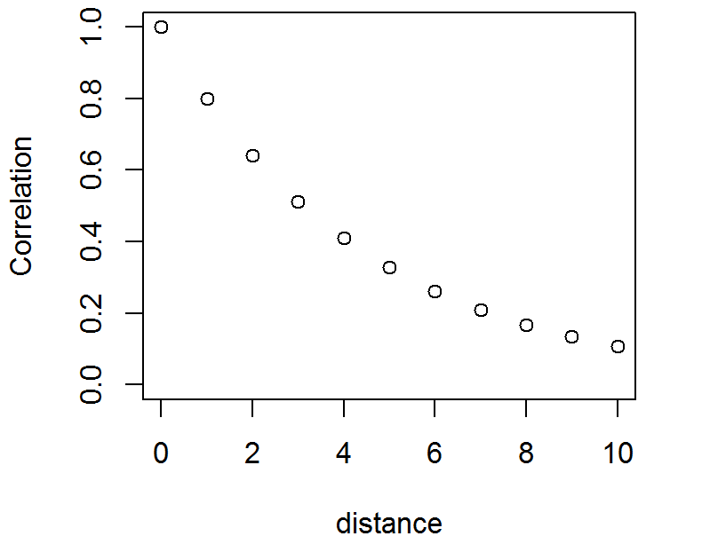

Review: Equal distance autoregression
$$c(s)\sim g\left(μ(s)\right)$$
$$μ\left(s\right)=x(s)β+ε(s)$$
Let’s assume first-order autoregression:
$$ε(s+1)\sim Normal(ρε(s),σ_{ε}^{2})$$

Slide 4
What if you want to model unequal distances?

Slide 5
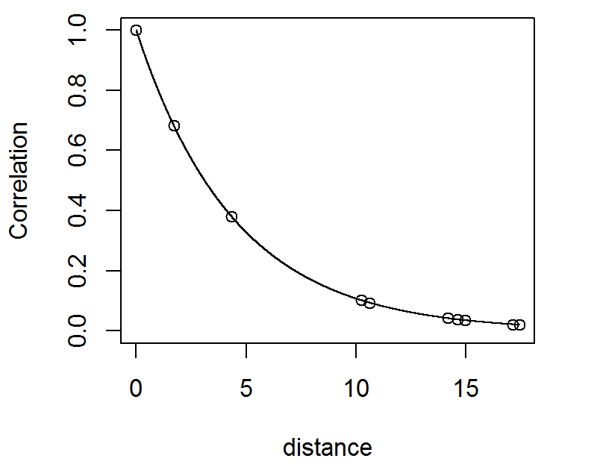
What if you want to model unequal distances?

Slide 6
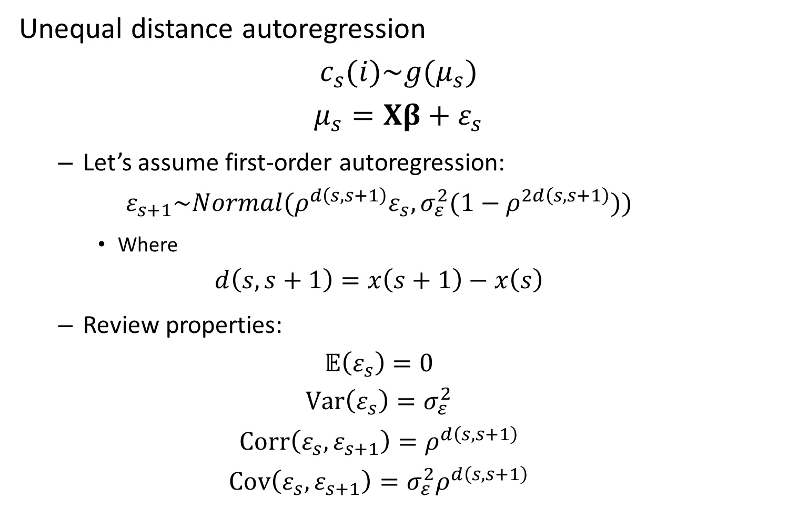
Unequal distance autoregression
$$c_{s}(i)\sim g(μ_{s})$$
$$μ_{s}=Xβ+ε_{s}$$
Let’s assume first-order autoregression:
$$ε_{s+1}\sim Normal(ρ^{d\left(s,s+1\right)}ε_{s},σ_{ε}^{2}(1−ρ^{2d\left(s,s+1\right)}))$$
Where
$$d\left(s,s+1\right)=x\left(s+1\right)−x\left(s\right)$$
Review properties:
$$𝔼\left(ε_{s}\right)=0$$
$$Var\left(ε_{s}\right)=σ_{ε}^{2}$$
$$Corr\left(ε_{s},ε_{s+1}\right)=ρ^{d\left(s,s+1\right)}$$
$$Cov\left(ε_{s},ε_{s+1}\right)=σ_{ε}^{2}ρ^{d\left(s,s+1\right)}$$

Slide 7
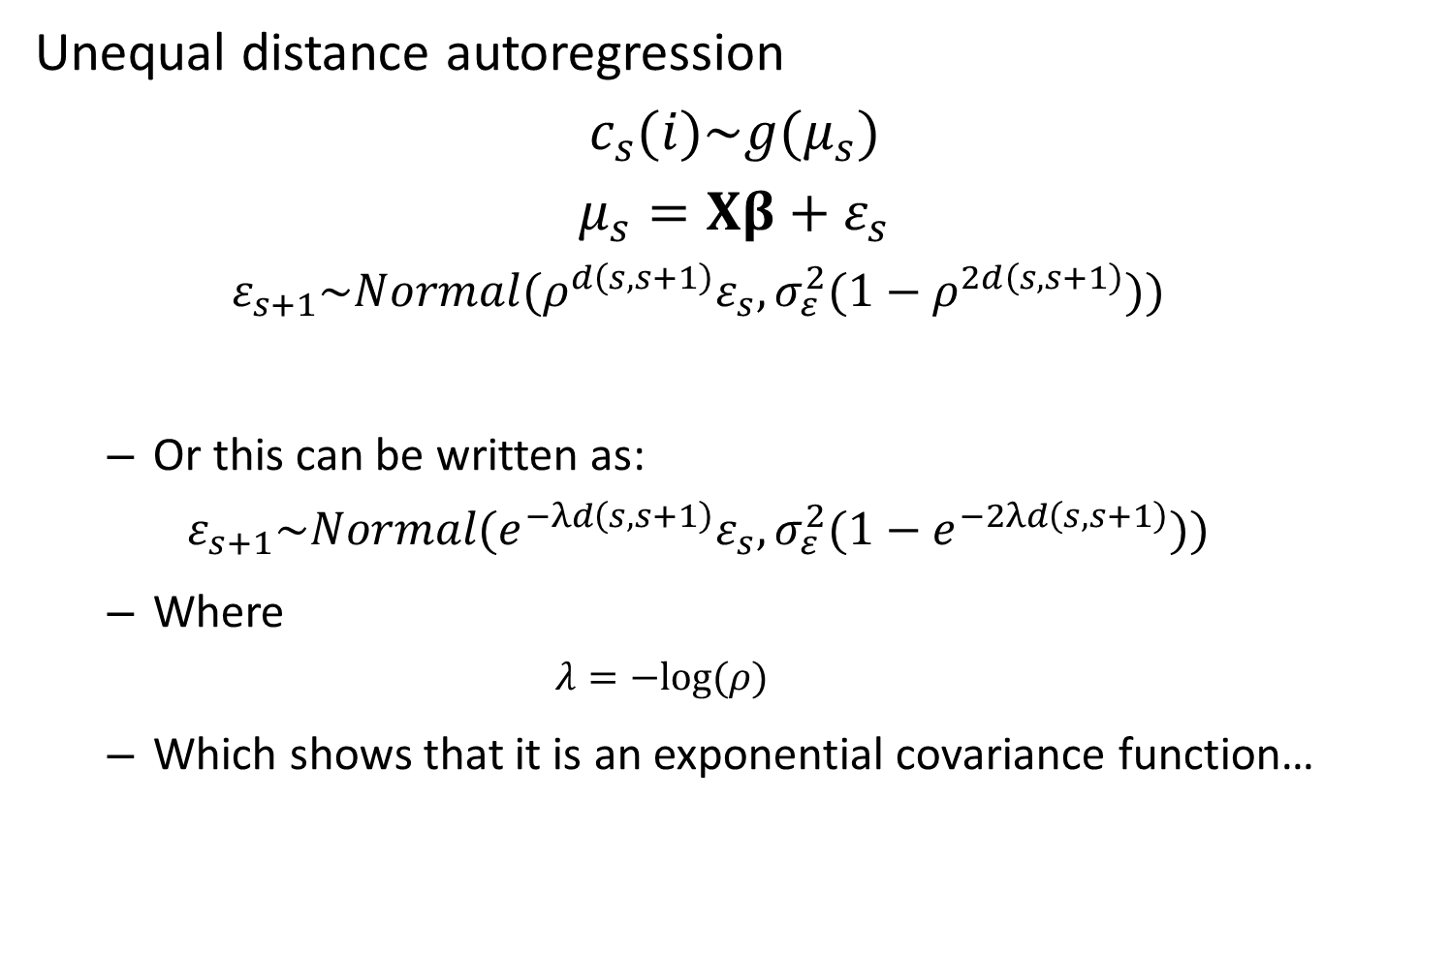
Unequal distance autoregression
$$c_{s}(i)\sim g(μ_{s})$$
$$μ_{s}=Xβ+ε_{s}$$
$$ε_{s+1}\sim Normal(ρ^{d\left(s,s+1\right)}ε_{s},σ_{ε}^{2}(1−ρ^{2d\left(s,s+1\right)}))$$
Or this can be written as:
$$ε_{s+1}\sim Normal(e^{−λd\left(s,s+1\right)}ε_{s},σ_{ε}^{2}(1−e^{−2λd\left(s,s+1\right)}))$$
Where
$$λ=−log⁡(ρ)$$
Which shows that it is an exponential covariance function…

Slide 8

Unequal distance autoregression
$$c_{s}(i)\sim g(μ_{s})$$
$$μ_{s}=Xβ+ε_{s}$$
Then…
$$ε\sim MVN(0,Σ)$$
where

Slide 9
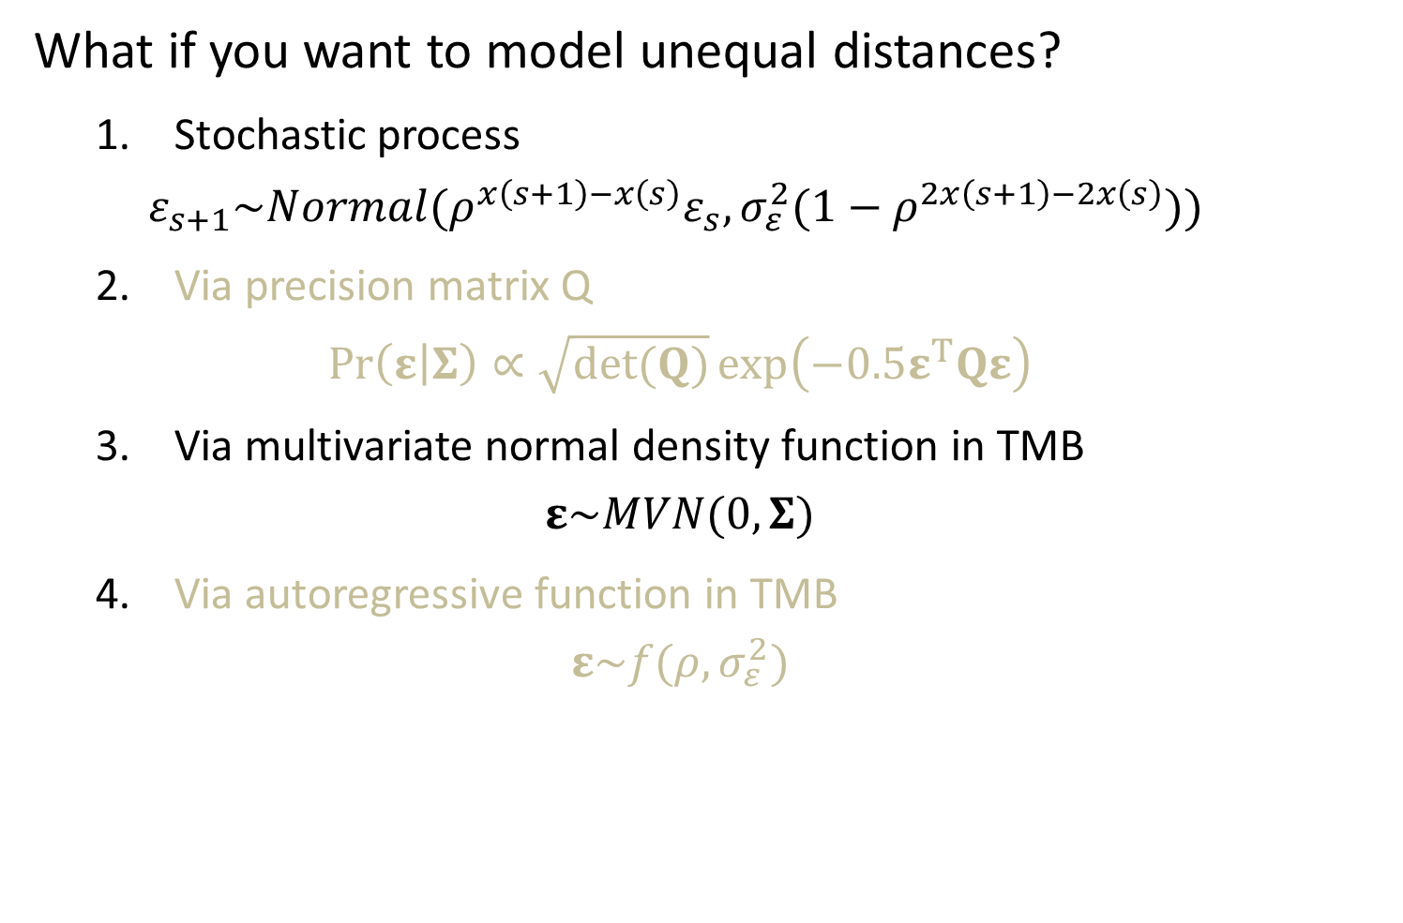
What if you want to model unequal distances?
1. Stochastic process
$$ε_{s+1}\sim Normal(ρ^{x\left(s+1\right)−x\left(s\right)}ε_{s},σ_{ε}^{2}(1−ρ^{2x\left(s+1\right)−2x\left(s\right)}))$$
2. Via precision matrix Q
$$\operatorname{Pr}\left(ε | Σ\right)∝\sqrt{det(Q)}\exp\left(−0.5ε^{T}Qε\right)$$
3. Via multivariate normal density function in TMB
$$ε\sim MVN(0,Σ)$$
4. Via autoregressive function in TMB
$$ε\sim f(ρ,σ_{ε}^{2})$$

Slide 10
[Show R and TMB code for 2 ways to code this]

Slide 11
Lessons:
Speed
Again, stochastic is easier than covariance-based calculation
Avoids need to assemble covariance matrix
Unequal-interval models generalize the equal-interval models
Generally true that continuous treatment generalizes discrete treatment

Slide 12
When else does separability break down?
[Exercise: Compare version 2 for the exponential covariance function with a new covariance function, and inspect the Hessian for each]

Slide 13
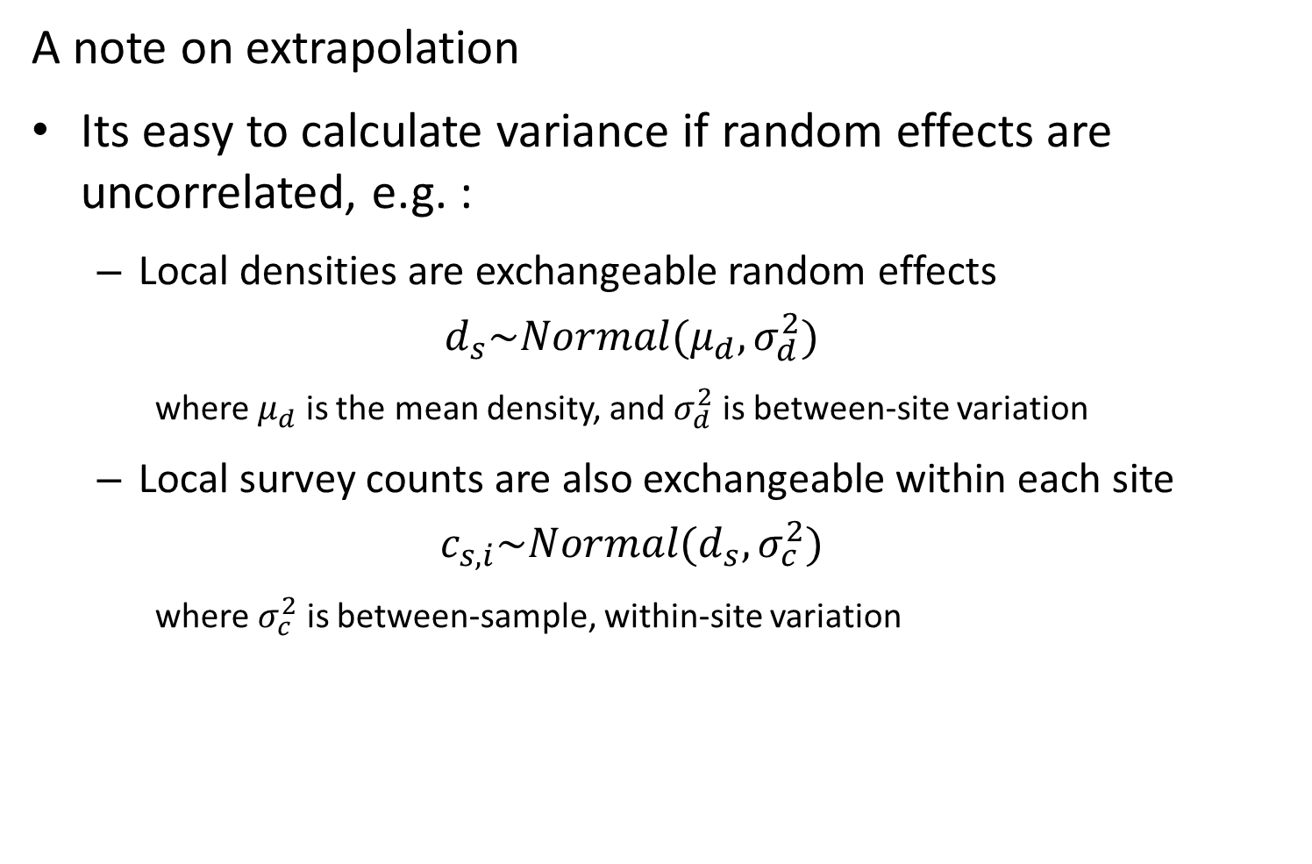
A note on extrapolation
Its easy to calculate variance if random effects are uncorrelated, e.g. :
Local densities are exchangeable random effects
$$d_{s}\sim Normal(μ_{d},σ_{d}^{2})$$
where $μ_{d}$ is the mean density, and $σ_{d}^{2}$ is between-site variation
Local survey counts are also exchangeable within each site
$$c_{s,i}\sim Normal(d_{s},σ_{c}^{2})$$
where $σ_{c}^{2}$ is between-sample, within-site variation

Slide 14
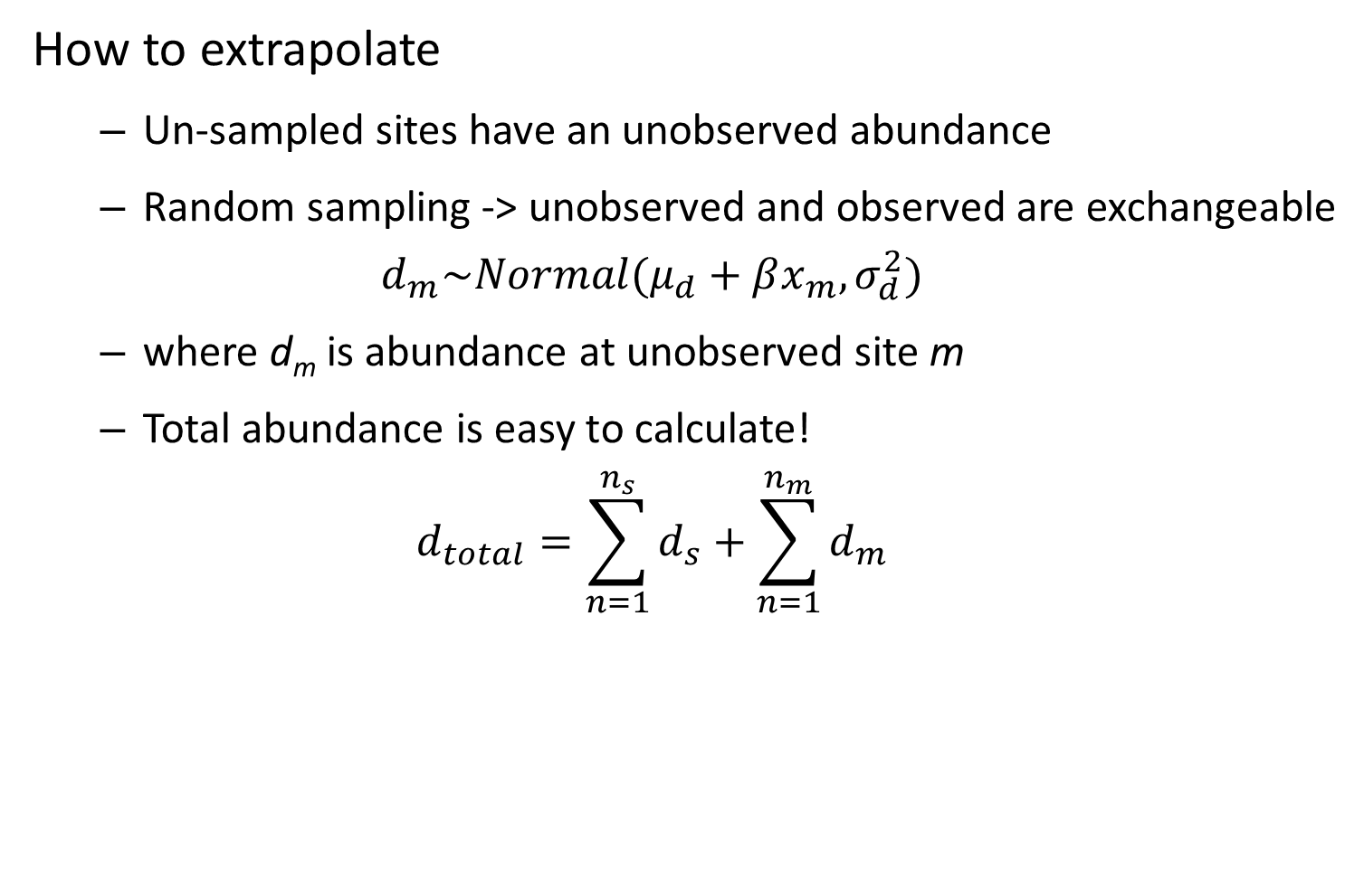
How to extrapolate
Un-sampled sites have an unobserved abundance
Random sampling -> unobserved and observed are exchangeable
$$d_{m}\sim Normal(μ_{d}+βx_{m},σ_{d}^{2})$$
where d_{m} is abundance at unobserved site m
Total abundance is easy to calculate!
$$d_{total}=\sum_{n=1}^{n_{s}}{d_{s}}+\sum_{n=1}^{n_{m}}{d_{m}}$$

Slide 15
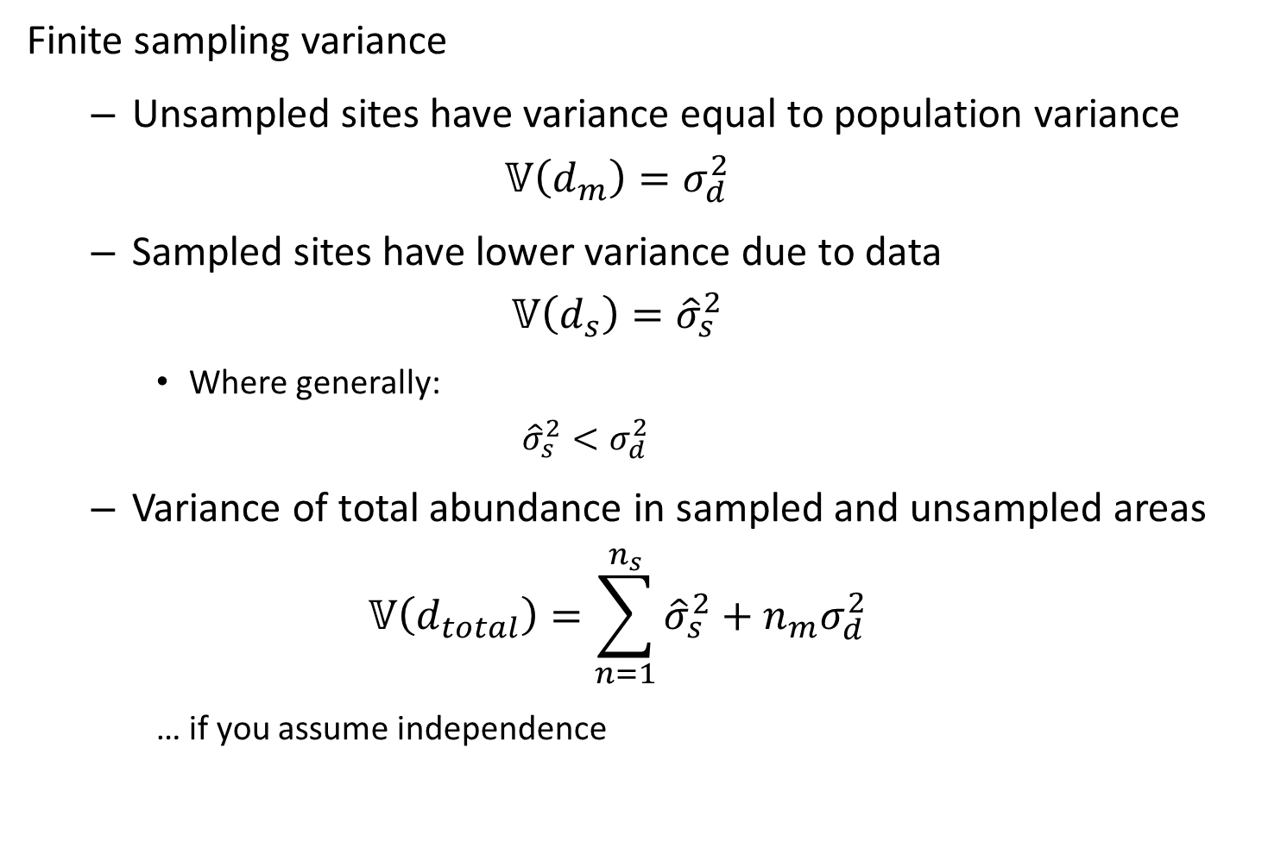
Finite sampling variance
Unsampled sites have variance equal to population variance
$$𝕍\left(d_{m}\right)=σ_{d}^{2}$$
Sampled sites have lower variance due to data
$$𝕍\left(d_{s}\right)={\hat{σ}}_{s}^{2}$$
Where generally:
$${\hat{σ}}_{s}^{2}<σ_{d}^{2}$$
Variance of total abundance in sampled and unsampled areas
$$𝕍\left(d_{total}\right)=\sum_{n=1}^{n_{s}}{{\hat{σ}}_{s}^{2}}+n_{m}σ_{d}^{2}$$
… if you assume independence

Slide 16
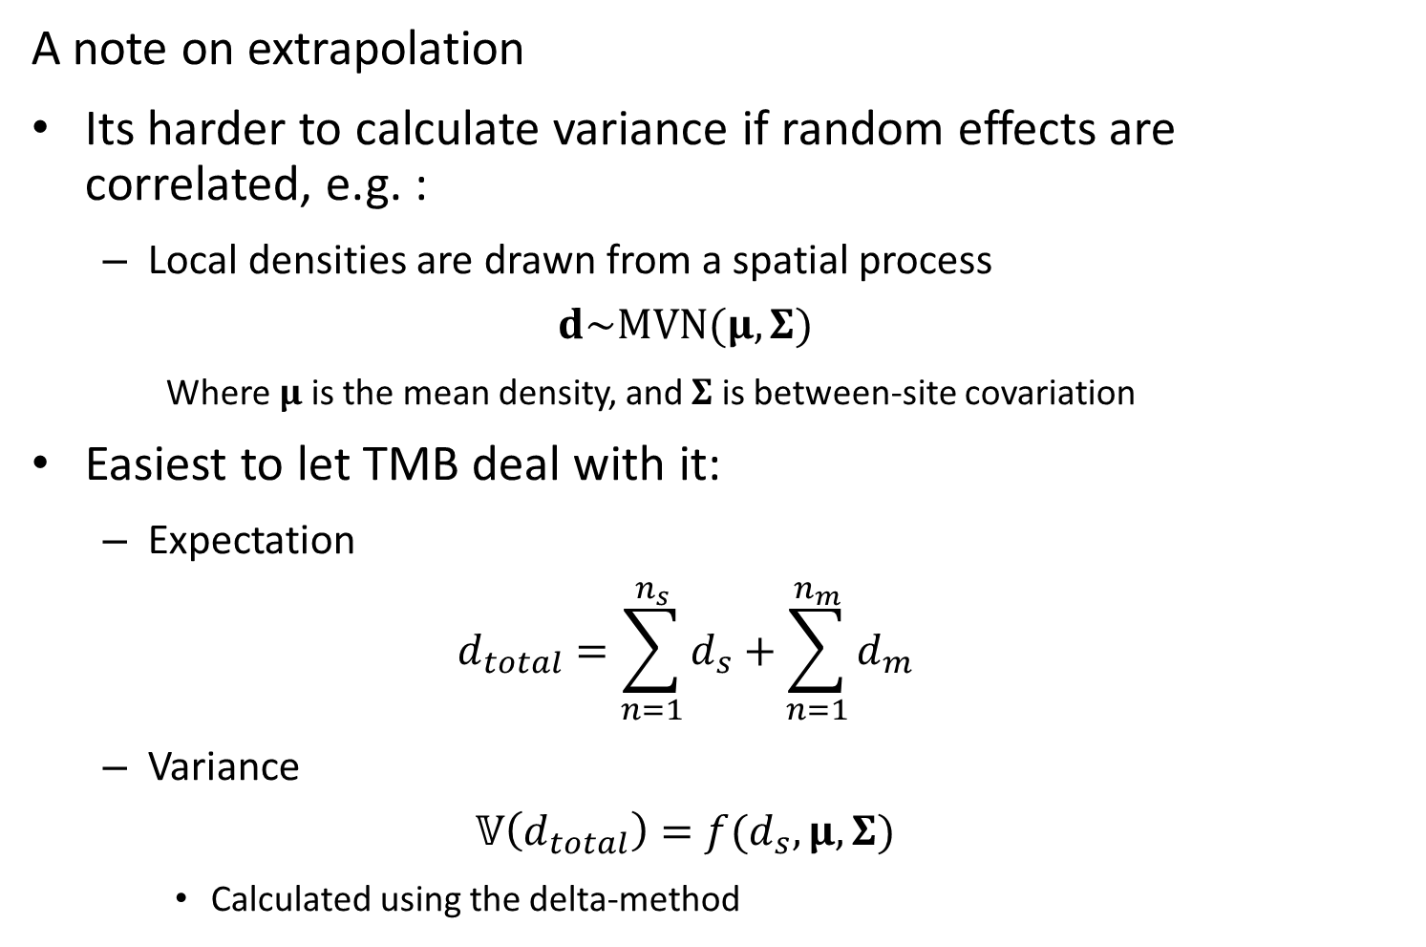
A note on extrapolation
Its harder to calculate variance if random effects are correlated, e.g. :
Local densities are drawn from a spatial process
$$d\sim MVN(μ,Σ)$$
Where $μ$ is the mean density, and $Σ$ is between-site covariation
Easiest to let TMB deal with it:
Expectation
$$d_{total}=\sum_{n=1}^{n_{s}}{d_{s}}+\sum_{n=1}^{n_{m}}{d_{m}}$$
Variance
$$𝕍\left(d_{total}\right)=f(d_{s},μ,Σ)$$
Calculated using the delta-method

